Slide 1




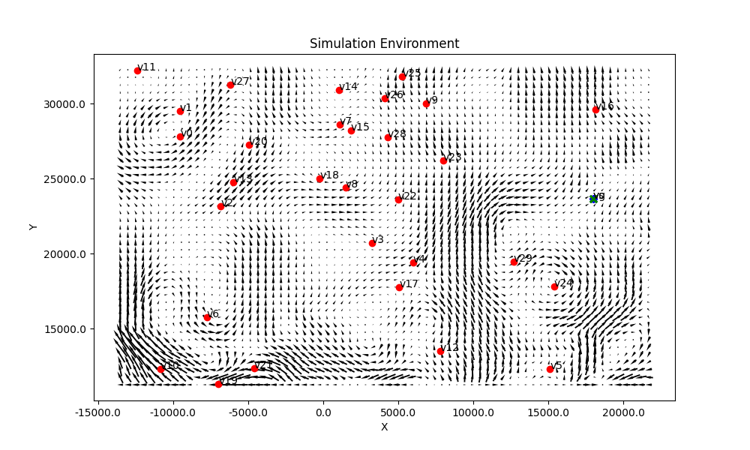
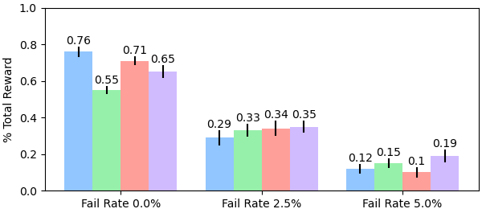
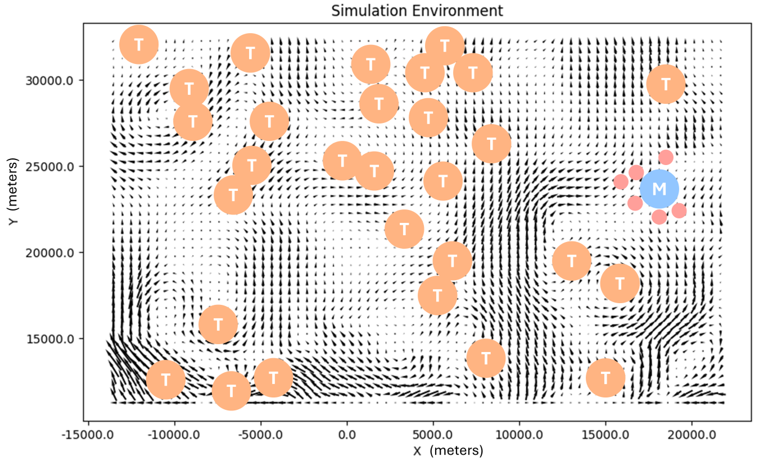
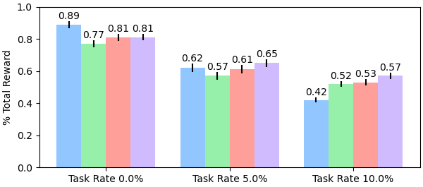



butlnath@oregonstate.edu
natbut.github.io
Hybrid Decentralization for Multi-Robot Orienteering with Mothership-Passenger Systems
Nathan L. Butler and Geoffrey A. Hollinger
Collaborative Robotics and Intelligent Systems (CoRIS) Institute, Oregon State University
Multi-robot teams are useful for efficiently exploring isolated, hazardous environments.
If reaching the environment is itself a hazardous task, a larger mothership robot can be used to first transport the team to regions of interest.
Once the team is deployed, passengers must solve a challenging Stochastic Multiagent Orienteering Problem to allocate tasks, plan paths, and return to the mothership for extraction within a travel budget in a stochastic environment.
This problem is typically solved in a fully decentralized manner that struggles to produce globally-coordinated plans.
Opportunity: How can we leverage a hybrid centralized-decentralized network available in Mothership-Passenger systems to solve complex orienteering problems?
Marine under-ice mission planning
Hybrid Decentralized Mission Planning
We inject plans developed by a powerful centralized planner onboard the mothership into passengers’ decentralized planning routines to improve system-level coordination.
Mothership
Mothership
Aggregate observations from connected passengers.
Use centralized solver to compute joint team plans.
Share solutions with connected passengers.
Centralized Solver
$$P_{i−1}^{}$$
$$P_{i}^{}$$
$$P_{i+1}^{}$$
Sampling-based solvers address environment stochasticity
Passenger i
Solve local plan using observations & candidate plans from neighbors.
Evaluate new plans against history of high-value solutions (both solved locally & received from mothership).
Store & share distribution of high-value plans.
Stored Plans
Decentralized Solver
Plan Valuation & Selection
Passengers’ decentralized planning routine supports coordination with neighbors in communication range. Plans received from the mothership align passenger actions with distant robots as well.
Neighboring Robots
Candidate Plans
Experiments and Results
We evaluate our framework in a simulated underwater environment.
Tasks (T) and the mothership location (M) are distributed randomly.
Ocean currents from high-fidelity underwater simulator provide stochastic travel times.
We compare four algorithmic variants:
Offline, centralized solution only
Decentralized planning only
Offline + decentralized replanning
Offline + hybrid replanning
We inject disturbances (robot failures, new tasks) at specified rates into the system.
These disturbances introduce heterogeneity in team observations and allow us to evaluate each method’s performance in replanning.
3 Robots, 30 Tasks
6 Robots, 20 Tasks
Our hybrid planning framework offers an initial performance boost from the mothership’s centralized solver. Global coordination provided by the mothership improves system robustness in high-disturbance scenarios.
Acknowledgements: Financial support provided by U.S. National Science Foundation, award #2322055. Special thanks to our collaborators at Arizona State University, Brigham Young University, Purdue University, Temple University, and Woods Hole Oceanographic Institution.

Slide 2
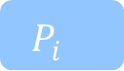
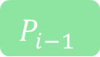
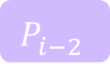
Mothership
Mothership
Mothership
Passenger i
Centralized Solver
Stored Plans
Decentralized Solver
Neighboring Robots
$$P_{i−2}^{}$$
$$P_{i−1}^{}$$
$$P_{i}^{}$$
Plan Valuation & Selection
Candidate Plans

